Slide 1

Project Demo-
AutoHub
Date : 06/11/24

Slide 2
Agenda
Project overview
Core features
Technology stack
Architecture overview
Key integrations
Challenges and solutions
Future enhancements

Slide 3

Project Overview
Goal:
To create a comprehensive used car marketplace that connects buyers, sellers, and service providers.
Objectives:
Streamline user interactions in a secure environment.
Integrate AI to estimate car prices.
Provide a comprehensive admin dashboard for platform management.

Slide 4
Core Features
User Features:
List and sell used cars.
Book used cars and car services from various providers.
Access AI-estimated market prices.
Admin Features:
Monitor website analytics: car sales, revenue, most popular brands.
Approve listings, manage users, services, and service providers.
Other Functionalities:
Firebase-based authentication and secure routing.
Image storage via Cloudinary.
Access ex-showroom prices for comparison.

Slide 5
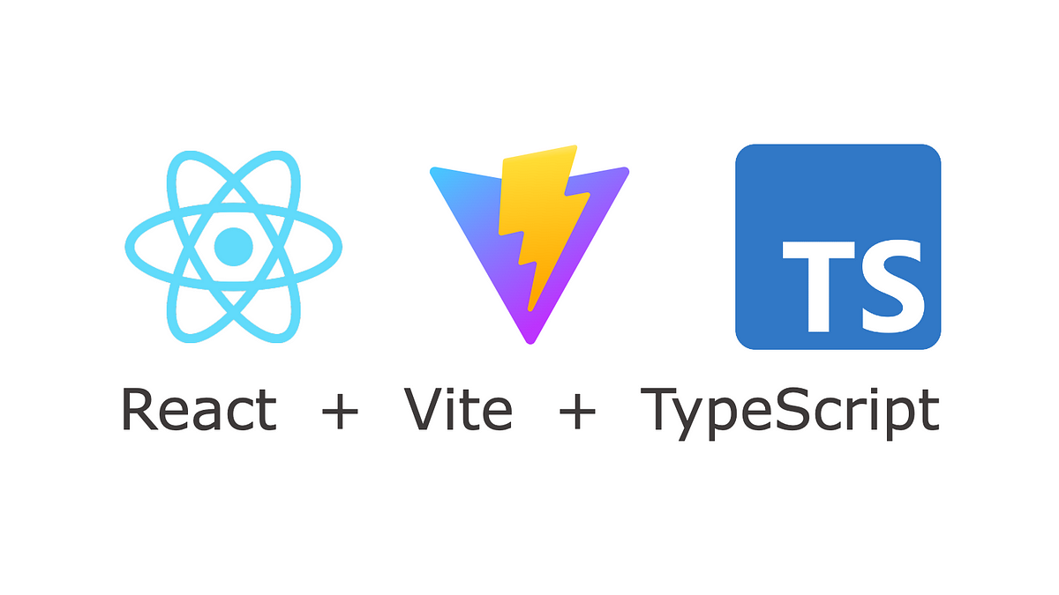

Technology Stack
Frontend:
React with TypeScript and Context API.
Bootstrap and Material UI for UI
Backend:
Node.js and Express for REST APIs.

Slide 6


Technology Stack
Database:
MongoDB for document-based storage.
Mongoose for schema modeling.
APIs and Cloud Services:
Gemini AI API for market price estimation.
Cloudinary for image storage.
Firebase for authentication.

Slide 7
Architecture Overview
MERN Stack:
React (Frontend), Express + Node.js (Backend), MongoDB (Database).
Microservices:
User Service, Used car service, Service provider, Notification service,
Flow:
User and admin authentication, session management, and role-based access control.

Slide 8
Key Integrations
Gemini AI API:
Estimates the current market price for used cars based on condition and other parameters.
Firebase Authentication:
Secures routes using user roles.
Cloudinary:
Stores images of car listings, reducing storage load on the server.

Slide 9
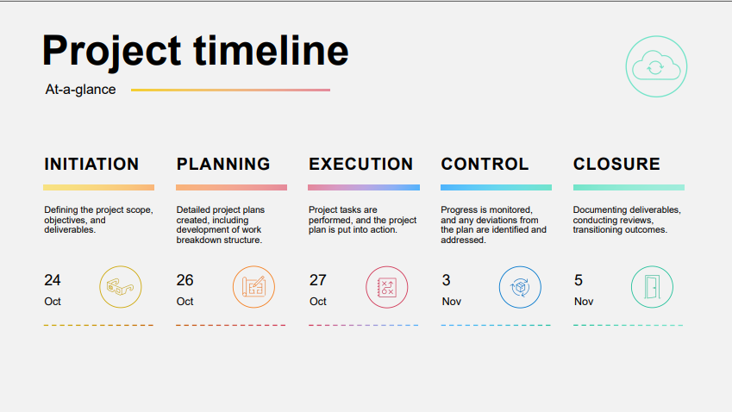

Slide 10

Challenges and Solutions
Image Storage:
Solution: Cloudinary API integration for efficient image storage.
Securing Admin Routes:
Solution: Firebase authentication combined with Express middleware for route security.
Price Prediction:
Solution: Used Gemini AI API to deliver market estimates on car condition and make/model.

Slide 11
Future Enhancements
Payment gateway integration for secure transactions.
Real-time chat between buyers and sellers.
Enhanced search filters using advanced algorithms.
AI-based recommendation engine for cars and services.

Slide 12

Thank You

